Slide 1
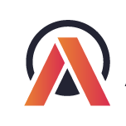
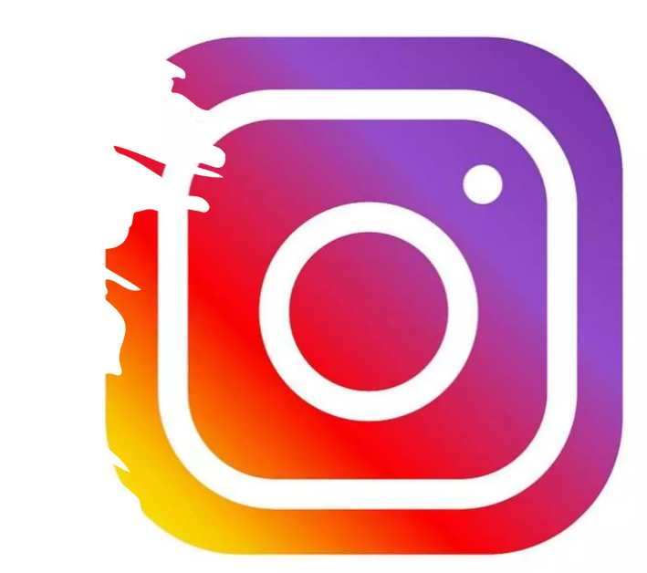

AtliQ
Technologies
Instagram Account Analytics
Virtual Internship
Notes:
Welcome everyone to the presentation.
Today, i will be sharing my analysis on the performance of an Instagram tech influencer's account.
This project is conducted by AtliQ Technologies as part of a virtual internship program.
The goal is to uncover insights that can help improve engagement and growth strategies.

Slide 2

OVERVIEW-Introduction and goal of the project
1
DATA-Data sources and details of information
2
Agenda
INSIGHTS-Queries for request from Social media analytics team
3
PERFORMANCE OVERVIEW-Overview of Influencer account
4
RECOMMENDATIONS-strategies to improve content reach and engagement
5
Notes:
Before we dive into the details, let’s take a quick look at the agenda for my presentation
Overview: Introduction to the project and its goal on optimizing a tech influencer's Instagram performance.
Data: I will mention data resources used for analysing account metrics, audience behavior, and content analysis.
Insights: I will answer Key trends in engagement, post performance, and audience preferences by solving problems given by social media analytics team
Performance Overview: I will share my Detailed analysis of follower growth, reach, and engagement metrics for this tech influencer account.
Finally I will provide Recommendations to improve content reach, engagement for an insatgram account

Slide 3
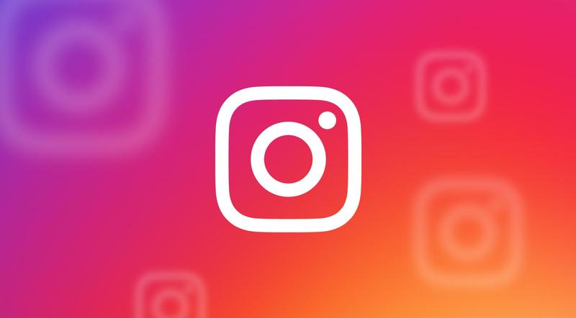
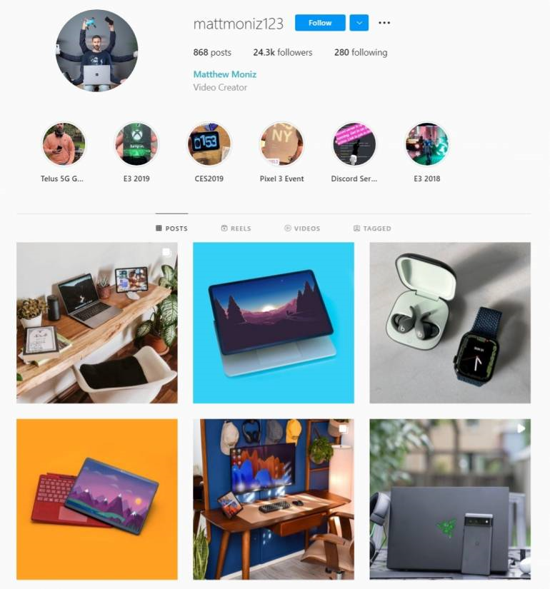
Overview
Introduction
Tech influencer primarily focuses on reviewing and showcasing gadgets, software, and tech tips.
Their content includes unboxing and testing the latest smartphones, laptops, and other cutting-edge devices, as well as providing practical advice on using various software tools and applications.
They also share tips and tricks to help their followers optimize technology in their daily lives, making complex tech concepts more accessible to a wider audience.
Analyzed Instagram activity data, including engagement metrics for posts, reels, and videos, to gain insights into the performance of a Tech Influencer's content strategy.
Objective
The objective is to explore activity data to uncover trends in follower engagement, evaluate the performance of different content types, and assess the overall effectiveness of the influencer's strategy to drive engagement and reach. Instagram's Stories and Reels provide dynamic formats for tech influencers to engage audiences, offering a closer look at product design and usability through visually-rich content.
Notes:
Tech influencer focuses on reviewing and showcasing gadgets, software, and tech trends.
Their content includes reviews of the latest smartphones, laptops, and accessories.
Their goal is to help followers optimize their tech use with informative content.
The objective is to analyze activity data to uncover trends in engagement and audience behavior.
Measure social effectiveness by tracking follower growth and content performance.
And Understand how visually rich content influences engagement in the tech space.

Slide 4

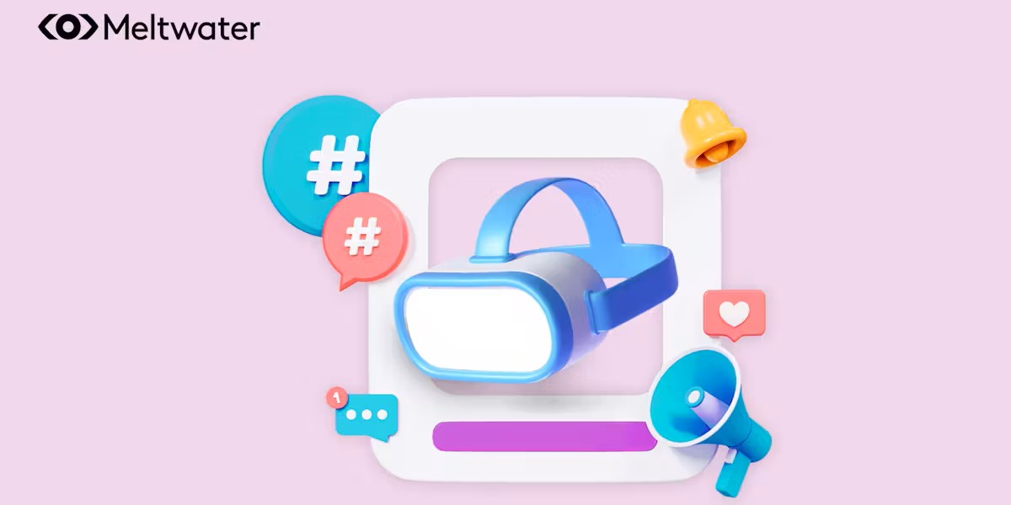
Data Resources
@username
New York, NY
Instagram Account Details
The analysis is based on Three key database tables containing detailed records of interactions, including user activity, engagement metrics and content performance recorded for 9 months-January to September
273
POSTS
3,02,513
NEW FOLLOWERS
4,48,013
PROFILE VISITS
Liked by username, username and 26 others
@username looking good!
See the 1,234 comments
1hours ago
1
1
1
Notes:
The analysis is based on three key database tables containing detailed records of:
User activities such as likes, comments, and shares.
Engagement metrics for each post.
Content performance recorded from January to September.
Key metrics:
273 posts were analyzed during the period.
3,02,513 new followers gained.
4,48,013 impressions achieved across all content.
These figures provide a solid foundation for understanding audience reach and interaction

Slide 5
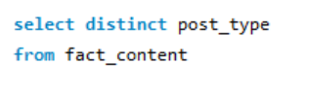
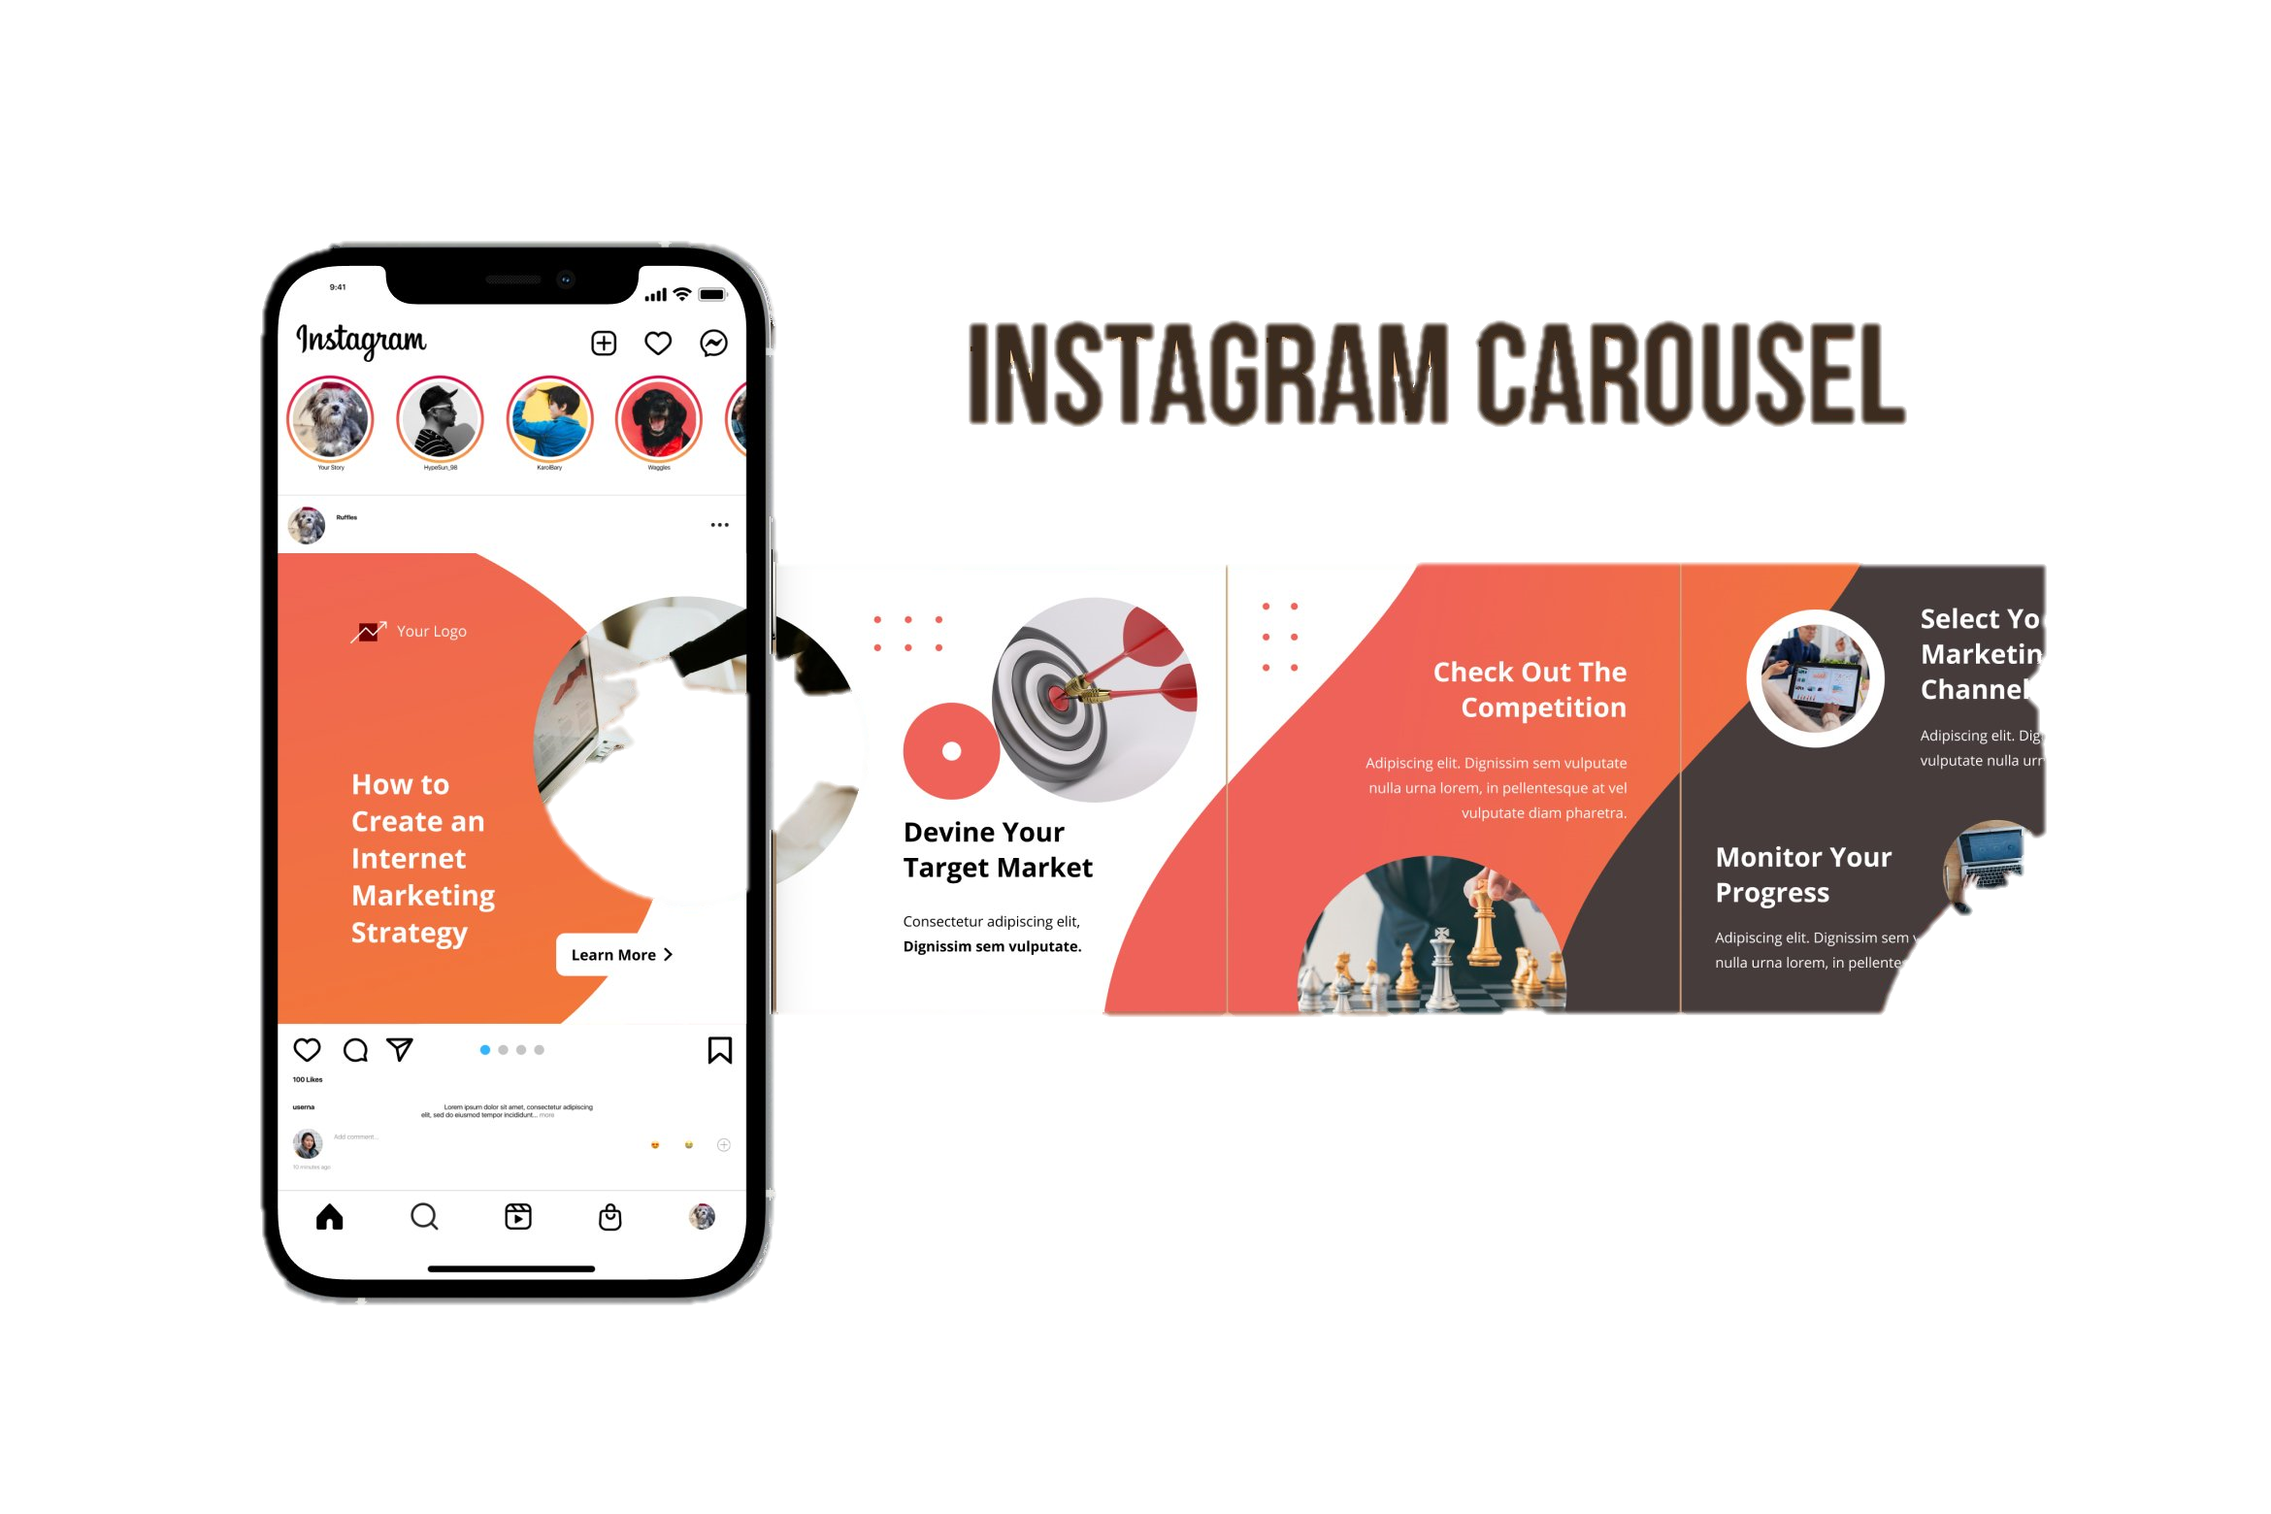
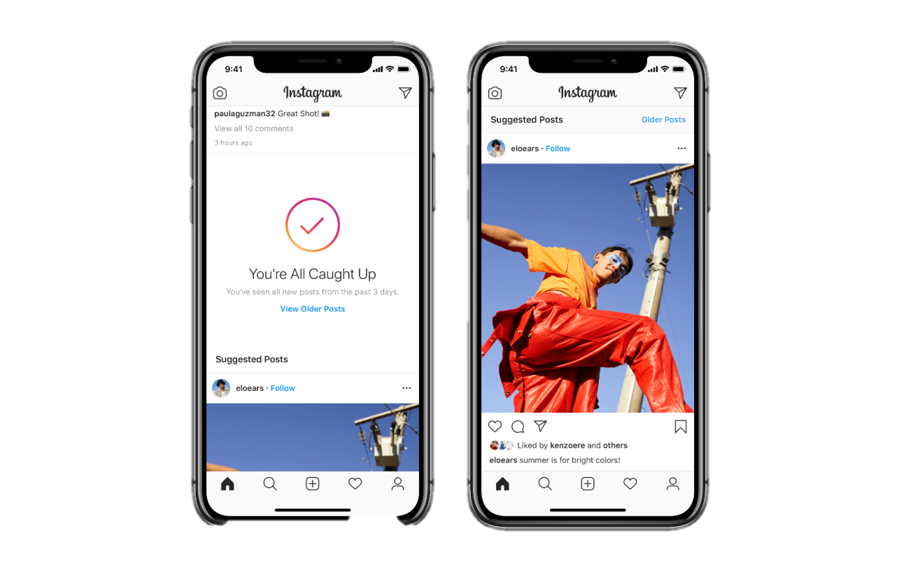
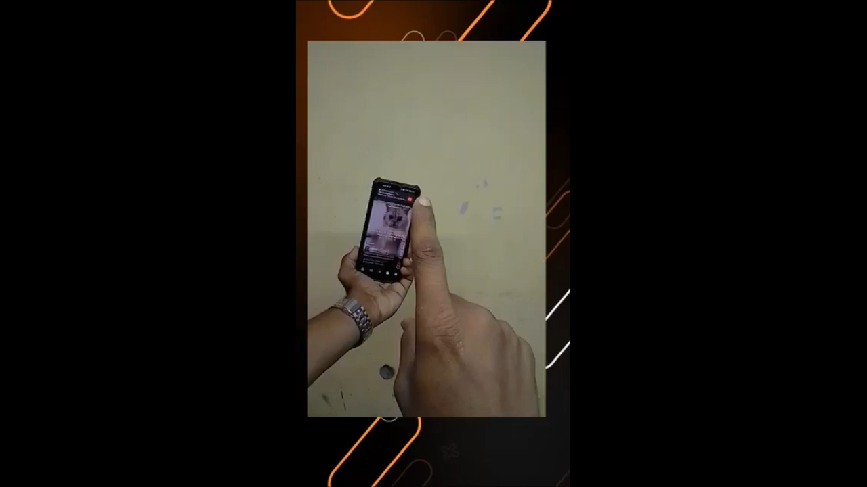





Insights
1.How many unique post types are found in the 'fact content' table?
IG Carousel
49 Posts
IG Video
88 Posts
IG Image
66 Posts
IG Reel
70 Posts
Notes:
The dataset contains four unique Instagram post types:
IG Carousel: 49 posts
IG Video: 88 posts
IG Image: 96 posts
IG Reel: 70 posts
Each content type has a different level of engagement and reach potential

Slide 6
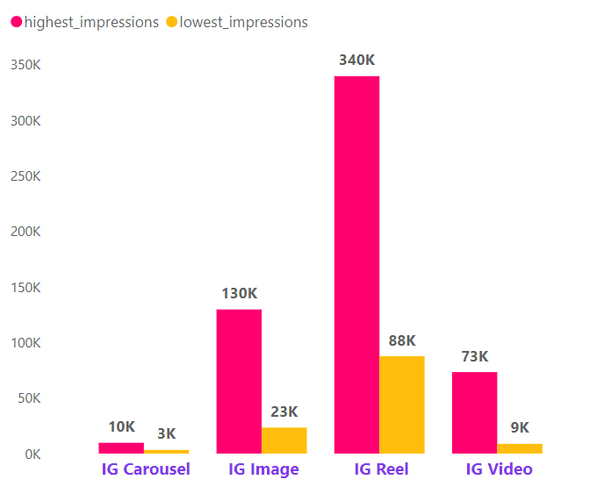
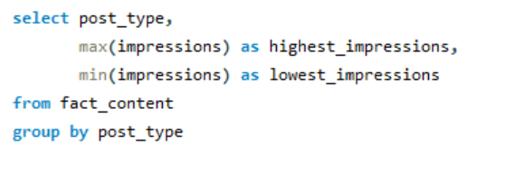
2. What are the highest and lowest recorded impressions for each post type?
Highest and Lowest Impressions by Post_type
IG Reels dominate in terms of impressions, making them the most effective content type for reaching a larger audience.
IG Carousels are the least impactful, suggesting they may need content strategy optimization.
Notes:
IG Reels dominate in terms of impressions, making them the most effective content type for reaching a larger audience.
IG Carousel posts have the lowest impact, suggesting the need for content strategy optimization.
This analysis helps in identifying the best-performing content types for better reach.

Slide 7
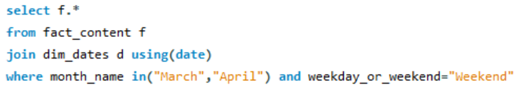
3.Filter all the posts that were published on a weekend in the month of March and April and export them to a separate csv file
Metric | Top Performer | Details
Post Type | IG Reel | Consistently had the highest impressions and engagement.
Top Post Impressions | Sunday, April 30, 2023 (IG Reel) | 185,017 impressions, 6,039 likes, 1010 shares.
Top Reach Post | Sunday, April 30, 2023 (IG Reel) | 63,990 reach, leading all other posts.
Category Performance | Mobile | Dominates impressions and reach across all post types.
Weakest Post Type | IG Carousel | Consistently low engagement and impressions.
Weekend Posting Insights | Both Saturdays and Sundays see steady activity | Engagement metrics favor Sundays slightly over Saturdays.
Notes:
Using this query I Filtered posts published on weekends in March and April and exported to a separate file for analysis.
And the Key findings from report are
Top-performing post type: IG Reels with the highest impressions and engagement (185,717 impressions, 6,039 likes, 1,010 shares).
Best performing post: April 30, 2023 (Sunday), with 63,190 reach.
Category performance: Mobile category dominates impressions and reach across all types.
Weakest post type: IG Carousels show consistently low engagement and impressions.
Weekend posting trends: Engagement is slightly lower on Sundays compared to Saturdays.

Slide 8
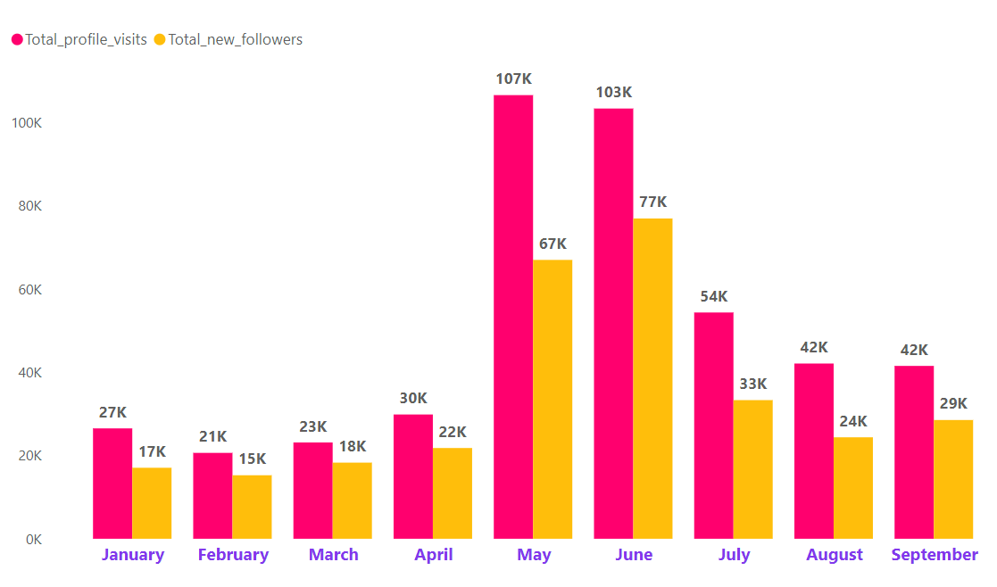
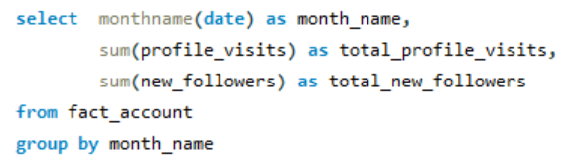
4.Create a report to get the statistics for the account
Total_profile_visits and Total_new_followers by Month
The beginning of the year, January to March, shows relatively lower activity with profile visits ranging between 21K–27K and new followers around 15K–18K. This could indicate slower growth or less impactful posts or campaigns.
Across the months, the ratio between profile visits and new followers remains steady. This suggests that the conversion rate of profile visits to followers is fairly consistent.
Notes:
The report provides monthly statistics on profile visits and new followers.
Key observations:
Profile visits were relatively low at the beginning of the year, with a peak in June.
June recorded the highest new followers, indicating a strong content strategy.
There is a correlation between profile visits and new followers, suggesting effective conversion strategies.
This trend analysis helps in understanding seasonal audience engagement patterns.

Slide 9
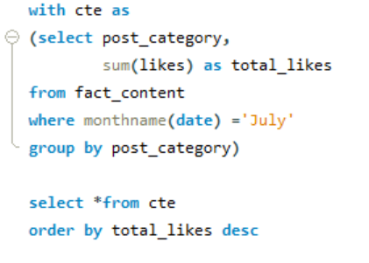
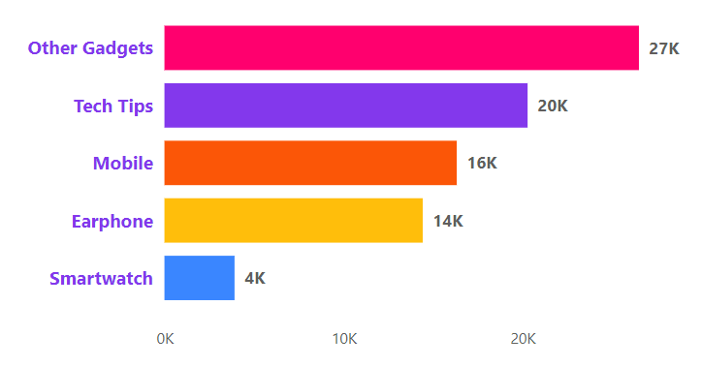
5.Write a CTE that calculates the total number of 'likes’ for each 'post category' during the month of 'July' and subsequently, arrange the 'post category' values in descending order according to their total likes
Total_likes by Post_category
Tech Tips followed as the second-best performing category, with 20,296 likes. This suggests that educational or informative content resonates well with the audience.
Mobile came third with 16,338 likes, showing consistent interest in mobile-related content
Notes:
A CTE query was used to calculate the total number of likes for each post category in July.
Key insights:
"Tech Tips" was best performing category with 27k likes, indicating audience preference for educational content.
"Mobile" content led with 16k likes, showing consistent interest in mobile-related posts.

Slide 10
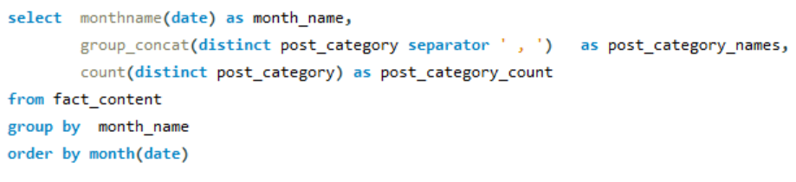
6.Create a report that displays the unique post category names alongside their respective counts for each month
Month | Post_category_names | Post_category_count
January | Earphone , Mobile , Smartwatch | 3
February | Earphone , Laptop , Mobile , Smartwatch | 4
March | Earphone , Laptop , Mobile , Smartwatch | 4
April | Earphone , Laptop , Mobile , Other Gadgets , Smartwatch | 5
May | Earphone , Laptop , Mobile , Other Gadgets , Smartwatch , Tech Tips | 6
June | Mobile , Other Gadgets , Smartwatch , Tech Tips | 4
July | Earphone , Mobile , Other Gadgets , Smartwatch , Tech Tips | 5
August | Earphone , Mobile , Other Gadgets , Smartwatch , Tech Tips | 5
September | Mobile , Other Gadgets , Smartwatch , Tech Tips | 4
Notes:
From this query A report was generated to display post category counts for each month.
The most consistent categories across months: Earphones, Mobile, Smartwatch.
Additional categories such as "Tech Tips" indicating content diversification.
May July and August featured the highest number of unique post categories.

Slide 11
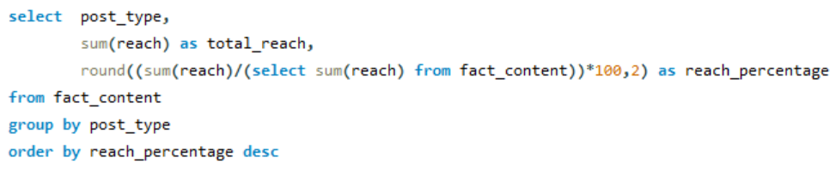
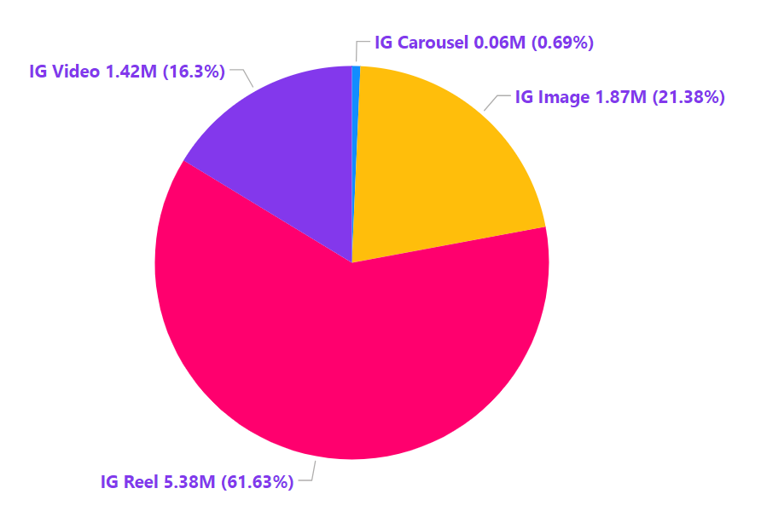
7.What is the percentage breakdown of total reach by post type?
Total_reach by post_type
Instagram's algorithms heavily promote Reels, which likely contributes to their dominance(61.63%)
Static posts (Images) still serve as a foundational format, but creators and brands may be shifting focus to video formats for better reach and engagement.
Notes:
IG Reels contribute 61.63% of total reach, highlighting their effectiveness.
IG Images and IG carousel contribute significantly less, suggesting a shift towards video-based formats for higher engagement.
Strategic focus should be on video content to maximize reach.

Slide 12
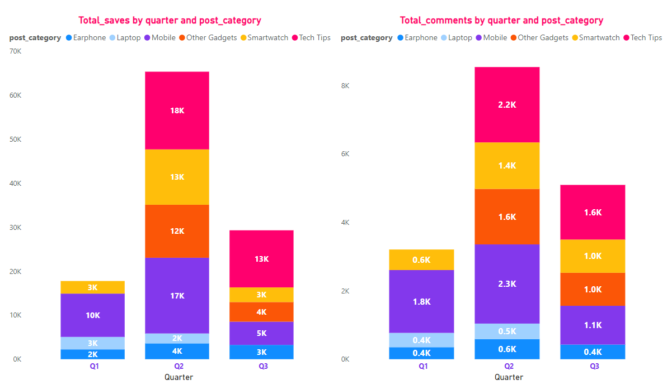
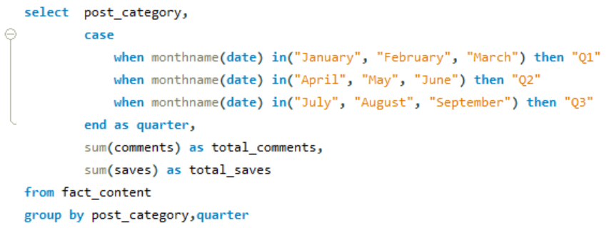
8.Create a report that includes the quarter, total comments, and total saves recorded for each post category
Q2 appears to have the highest engagement (saves and comments), with a significant peak in Mobile and Tech Tips categories.
"Tech Tips" consistently leads in both total saves and comments across quarters, with the highest performance in Q2 and Q3.
Notes:
Quarterly Community Engagement Report
A report was generated to analyze quarterly engagement in terms of comments and saves.
Key insights:
Q2 had the highest engagement levels, with "Tech Tips" emerging as the most engaging category.
The mobile category consistently performed well across quarters.
focusins on posting tech-related content in Q2 and Q3 gives maximum impact .

Slide 13
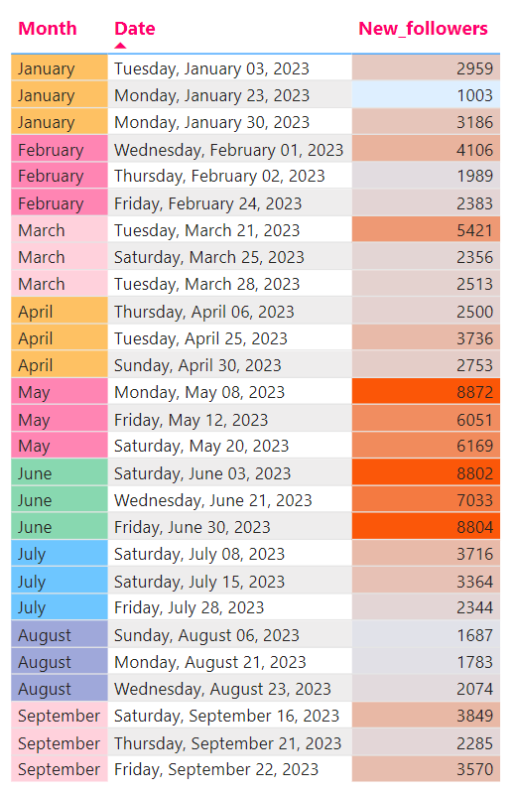
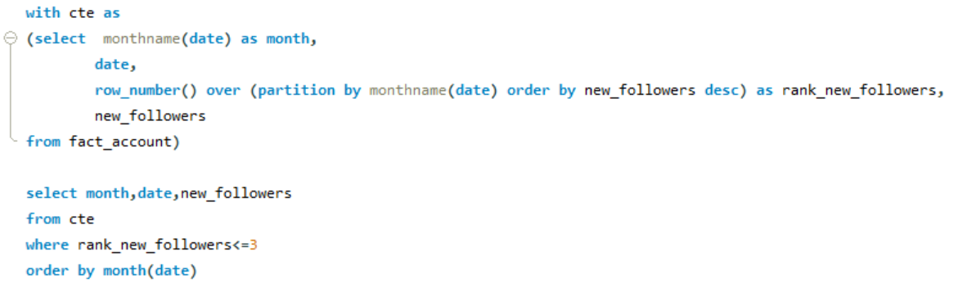
9. List the top three dates in each month with the highest number of new followers
Top 3 dates in each month with highest _new followers count
May and June are the most productive months for follower growth, with multiple high-performing dates.
April shows relatively lower activity compared to earlier months like February and March.
Certain months have standout dates with significantly higher new followers
June 3 (8802) and June 30 (8804) lead, showing spikes in engagement.
May 8 (8872) has the highest count, indicating a strong follower acquisition effort.
February 1 (4106) outperforms other dates in the month.
Notes:
Identified the top 3 dates in each month with the highest follower growth.
Insights:
May and June were the most productive months for gaining new followers.
Early months like February showed slower growth, emphasizing the need for stronger early-year strategies.

Slide 14
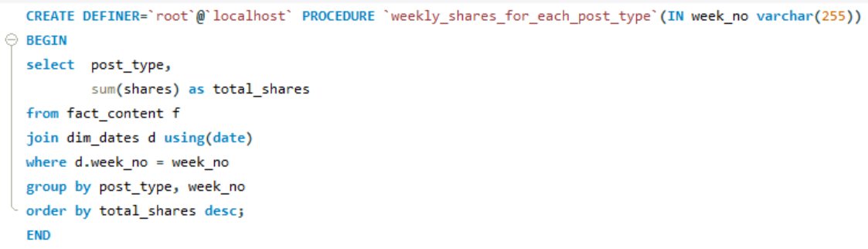
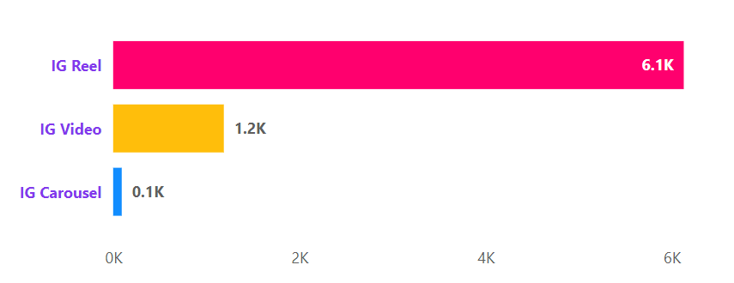
10.Create a stored procedure that takes the 'Week number' as input and generates a report displaying the total shares for each 'Post type'
Total_Shares by post_type for week 22
(highest number of shares in a week)
IG Reels are the most shared content in almost many weeks
IG Reels account for the largest share with 59.84% in all weeks.
Notes:
Weekly Shares Report
A stored procedure was created to analyze post shares by week.
Key findings:
Week 22 recorded the highest number of shares, primarily from IG Reels.
Which accounted for 59.84% of total shares, making them the most shareable content type.
Encouraging more IG Reel content can increase brand reach and engagement.

Slide 15

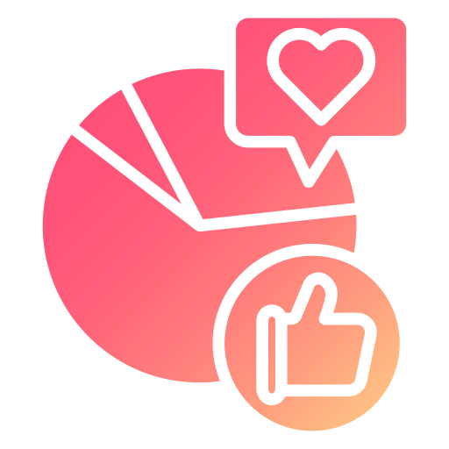
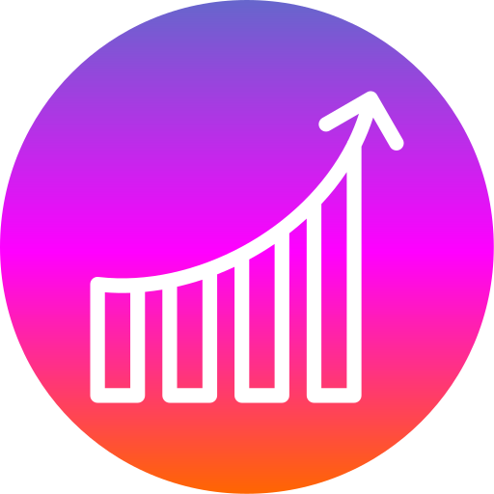

Performance Overview
67.5% Profile visits to New followers’ growth rate
51.6% Profile visits to Follows conversation rate
40.39%
Reach rate with 9M reaches and 22M impressions
4.15% Engagement rate
Follower Growth Rate (67.52%) - High Growth Potential
A high follower growth rate suggests that the account is attracting new users effectively.
Conversion Rate (51.60%) - Strong Profile Effectiveness
With over half of profile visits leading to follows, the profile's content is effective in converting visitors to followers.
Reach Rate(40.39%) - Good Organic Reach
Indicates a significant portion of impressions are translating into unique views.
Engagement Rate (4.15%) - Followers Interaction level
It suggests a decent level of audience interaction for influencers content
Notes:
These KPIs indicate a well-optimized influencer account.

Slide 16
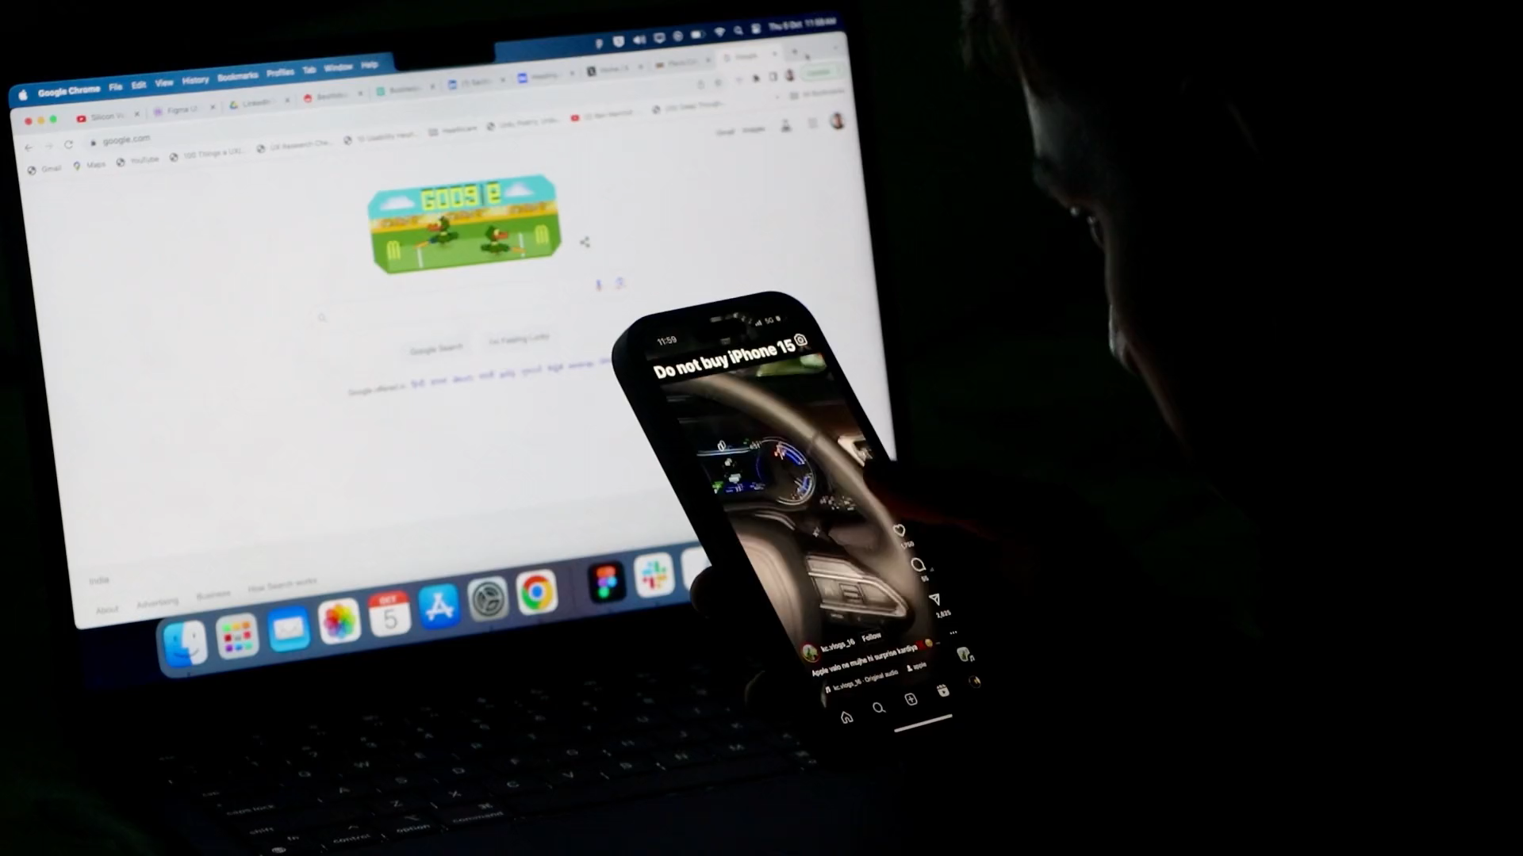
Recommendations
Engagement Trends
"Tech Tips" consistently perform well in likes and engagement. Regularly share practical, easy-to-understand tech tips.
Q2 shows peak engagement. Create campaigns tailored for summer tech trends, like vacation gadgets or productivity tools for students.
Content Strategy
Reels contribute significantly to engagement (61.63%). Prioritize creating more Reels with high-quality visuals, concise messaging, and trending audio to maintain audience interest.
IG Carousels have the lowest impressions. Experiment with interactive or visually engaging carousel designs, such as "Top 5 Gadgets of the Month" or "Step-by-Step Tech Tutorials."
Data-Driven Improvements &
Collaborations
Partner with other tech influencers or brands for crossover Reels or Lives. This can expand your reach and bring fresh content to your followers.
Regularly review analytics for high-performing post categories and adjust strategies accordingly.
Experiment with content formats and monitor reach, likes, and shares to refine your approach.
Interactive Content
Post unboxings, gadget reviews, or behind-the-scenes setups for your tech gear. Encourage authenticity by sharing challenges or "lessons learned" in tech, which builds trust.
Host weekly tech trivia or challenges to maintain regular audience interaction.
Notes:
Engagement Trends:
Focus on tech tips content, as it attracts the highest engagement.
Plan content around summer tech trends and student productivity tools.
Content Strategy:
Utilize reels and short videos to maintain high engagement.
Optimize posting times for better reach.
Develop series-based content like “Tech of the Month.”
Collaborations & Improvements:
Partner with tech influencers for increased reach.
Encourage challenges and tech hacks to sustain audience interest
Use analytics to fine-tune posting strategies based on engagement patterns.
Interactive Content:

Slide 17
AtliQ
Technologies
Thank You
Virtual Internship Project
Notes:
As influencers, your Instagram profiles are more than just accounts—they’re platforms to shape the way technology is shared and understood
I encourage all tech influencers to leverage these insights to optimize their Instagram strategy and achieve greater engagement and follower growth.
Remember, every post you share has the potential to educate, inspire, and connect—so make it count!"

